Slide 1

NAME: E.G.PRADEEP ROLL NO : RA2211004050026 DEP: B.TECH.ECE SUB: DESIGN THINKING METHODOLOGY SUB CODE : 21DCS201P

Slide 2
CONVERGENT THINKING: 1.CONVERGENT THINKING IS JUST OPPOSITE OF DIVERGENT THINKING. 2.THE CONCEPT OF CONVERGENT THINKING: ~THE DESIGN THINKER SHOULD GO THROUGH ALL POSSIBLE SOLUTIONS THOUGHT DURING DIVERGENT SOLUTIONS. ~HE SHOULD COME UP WITH CORRECT SOLUTION. 3.THE THINKER IS GENERALLY SUPPOSED TO COME WITH A SINGLE,WELLESTABLISHED,BEST POSSIBLE SOLUTION TO A PROBLEM. 4.IT REQUIRES SPEED,ACCURACY,EFFICIENCY,LOGICAL REASONING AND TECHNIQUES. 5.A THINKER IS SUPPOSED TO RECOGNIZE THE PATTERNS,REAPPLY A FEW TECHNIQUESAND ACCUMULATE AND ORGANIZE STORED INFORMATION.

Slide 3
CONVERGENT THINKING TOOLS : Convergent thinking tools are techniques or methods used to focus and narrow down options, ideas, or solutions to identify the best or most optimal outcome. Unlike divergent thinking, which involves generating multiple possibilities, convergent thinking aims to select the most appropriate option from among those generated. Here are some common convergent thinking tools: 1.Decision Matrix: A tool used to systematically evaluate and compare multiple options based on pre-defined criteria, helping to prioritize and select the best solution. 2.SWOT Analysis: An acronym for Strengths, Weaknesses, Opportunities, and Threats, used to assess the internal and external factors affecting a decision or solution, helping to identify the best course of action. 3.Pareto Analysis: Also known as the 80/20 rule, this tool helps identify the most significant factors contributing to a problem or situation, enabling prioritization of efforts on those areas that yield the greatest impact.

Slide 4
4.Cost-Benefit Analysis: A method used to evaluate the potential costs and benefits associated with different options or decisions, helping to determine the most economically viable or advantageous choice. 5.all.Decision Trees: A visual tool used to map out the possible outcomes and decisions in a structured manner, facilitating the identification of the most favorable path forward based on probabilities and potential consequences. 6.Force Field Analysis: A technique used to identify the driving forces (positive factors) and restraining forces (negative factors) influencing a decision or situation, helping to assess the balance between them and determine the feasibility of a particular course of action. 7.Criteria-Based Decision Making: Establishing clear criteria or parameters for evaluating options and systematically comparing them against these criteria to determine the best choice.

Slide 5
8.Multi-Voting: A technique used to prioritize options by allowing individuals to allocate a limited number of votes among their preferred choices, helping to identify the most favored option among a set of alternatives. 9.Weighted Decision Matrix: Similar to a decision matrix, but with assigned weights to different criteria based on their relative importance, enabling a more nuanced evaluation and selection process. 10.Pairwise Comparison: A method for systematically comparing each option against every other option in a pairwise fashion, helping to identify the option that is most preferred over

Slide 6
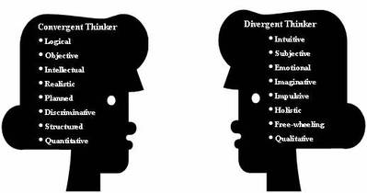
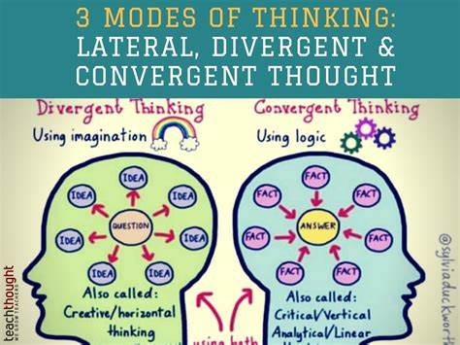

Slide 7
THANK YOU

